Slide 1
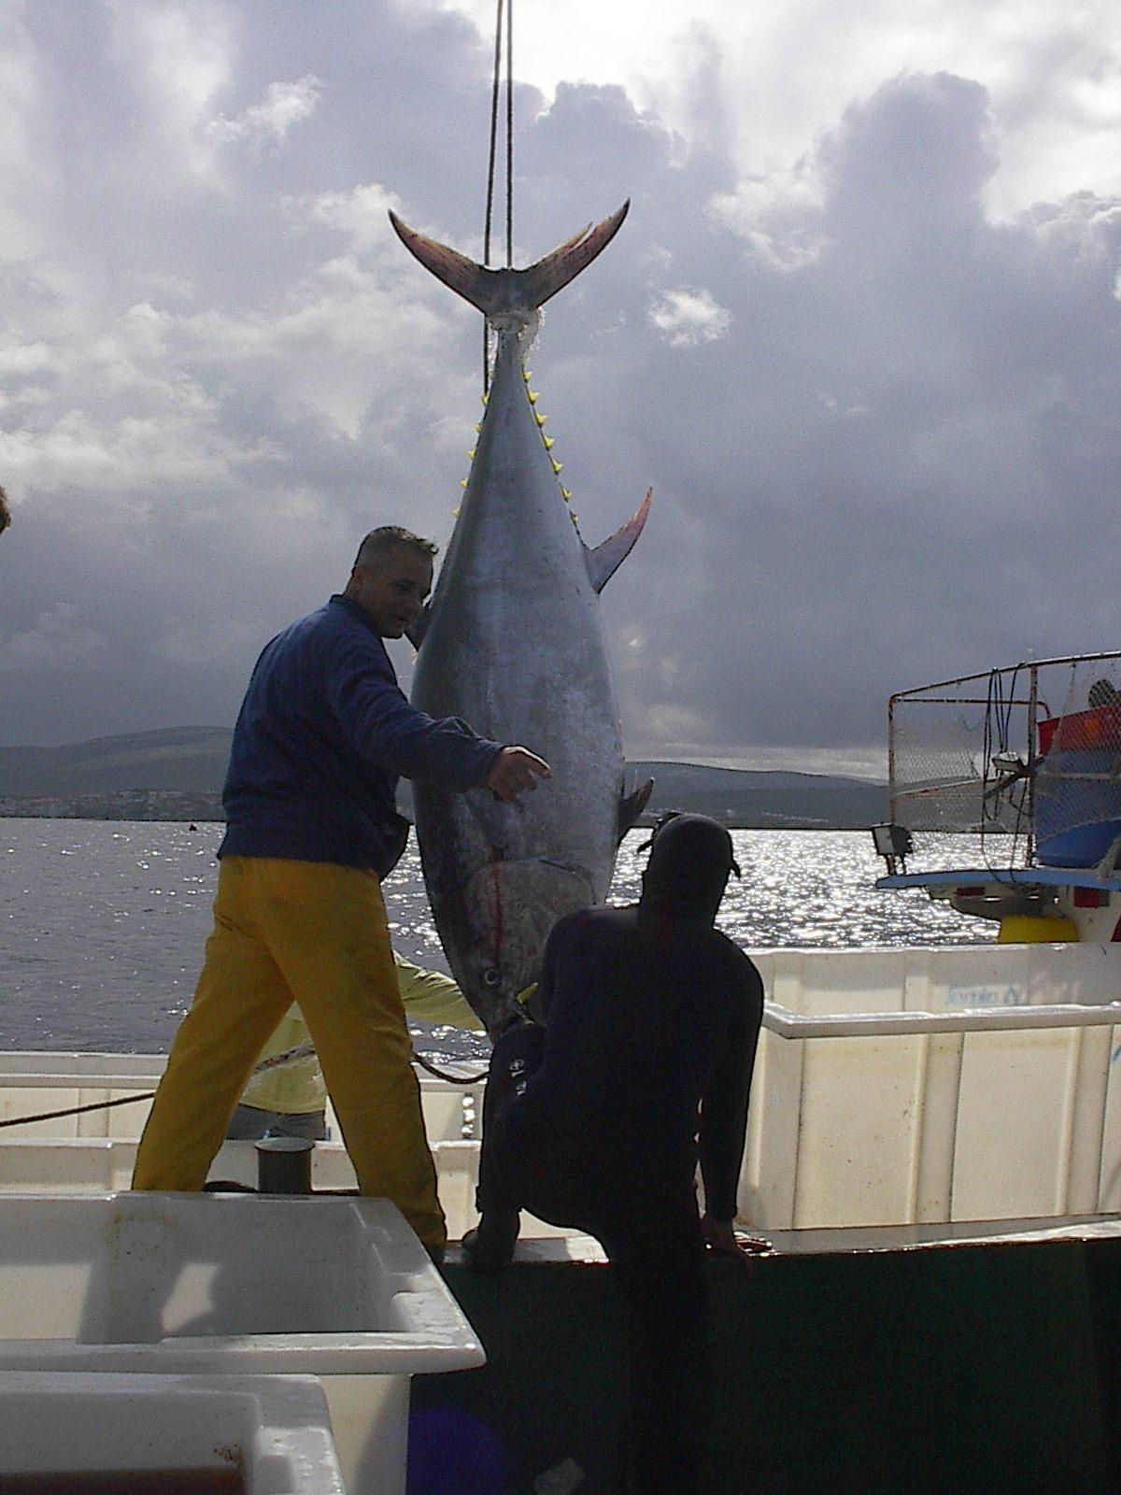
Agricultural Production Statistics Group
FISHERY STATISTICS

Slide 2
1- Introduction
Data on fishery statistics in our country were compiled by the Ministry of Commerce until 1967 based on records of provincial fish markets.
Fishery statistics cover data on sea products, freshwater and aquaculture products.

Slide 3
The production data of the large scale fishermen will be compiled monthly since May of 2014,
and
Data for small scale fishermen will be compiled seasonally.

Slide 4
2- Compiled data are:
  Quantity, price and value of fishery products
  Qualities of fishing vessels carrying out fishing activities by sea products regions
  The investments and expenditures for fishing activities
  The number of workers at fishing, total working day and payment.

Slide 5
3- Purpose
Compiling data is used to compute the national income and national accounts.
Obtaining data pertinent to the assesment of the condition and is usded for structure of the fishing sector for Five-Year Plans and Annual Programmes.
Compiling data includes quantity, price and value of fishery products
To determine the of distribution production and shape of marketing

Slide 6
To determine the characteristics of the vessel and fishing tools used in the fishery
To determine the amount of credit they received only for fishing activities of fishermen,
To compile information about the investments and expenses for fishing activities,
To determine the age and gender of employees in the fisheries and the working day and paid fees.

Slide 7
4- METHODS
Fishery statistics compiled by two types
a) Statistics of Sea Fishes and other sea products
b) Statistics of Fresh-Water Fish and Aquaculture Production.

Slide 8
Statistics of Sea Fishes and other sea products (Deniz Balıkları ve Diğer Deniz Ürünleri İstatistikleri )
1. Full census is used for large scale fishermen
Sea fish and other sea products statistics are compiled by Marine Fishery Survey applied annually.

Slide 9
This survey covers all professional fishermen fishing at territorial waters.
Fisherman is the statistical unit of the survey.
Professional Fisherman: A professional fishing person is defined as one of who engages in the activity of fishing in territorial waters for live hood and income and who employs specialized equipment and materials.

Slide 10
In the application, information of the previous year data is filled according to methods of face to face in coastal band of 28 provinces.
In this survey, the complete enumeration is used for large scale fishermen and the sampling method is used for small scale fishermen.

Slide 11
2. Sampling method is used for small scale fishermen.
Interviewers visit fishermen at their addresses and fill the questionnaires completely.

Slide 12
Large scale fishermen: It is a fisherman who has a vessel equal or more than 10 meters length.
The production data of the large scale fishermen is to be compiled monthly since May of 2014
Small scale fishermen: It is a fisherman who has a vessel less than 10 meters length.
Data for small scale fishermen will be compiled seasonally since May of 2014.

Slide 13
Freshwater and Aquaculture Statistics
(Tatlısu ve Yetiştiricilik İstatistikleri)
Freshwater and aquaculture questionnaires are sent to Province Directorates of MoFAL each year regularly.
These forms are compiled by staff of Province Directorates by interviewing with fishery cooperatives, fishery producers and aquaculture enterprises and are sent to MoFAL.

Slide 14
MoFAL compiles data by provinces according to the types and sent questionnaires to the TURKSTAT to analysis data.
Data on freshwater and aquaculture are taken directly from the Ministry of Food, Agriculture and Livestock.

Slide 15
Sampling method for seasonal Small scale fishermen
Stratified sampling method was used in a seasonal small scale fishermen survey. 27 provinces, located in coastal groups, used according to the stratification and boat length are given below:

Slide 16
Geographical coverage:
The data on sea products are presented at regional and national levels.
Data on freshwater products and aquaculture are presented at provincial and national levels.

Slide 18
Thank you for your attention

